Slide 1
Introduction to Topic Modelling
Prof.Aruna Malapati

Slide 2
Learning Objectives
Motivation for Topic Modelling
Generative model for Topic Model
The posterior distribution
Bernoulli and Beta distributions
Conjugate prior
Dirichlet distribution

Slide 3
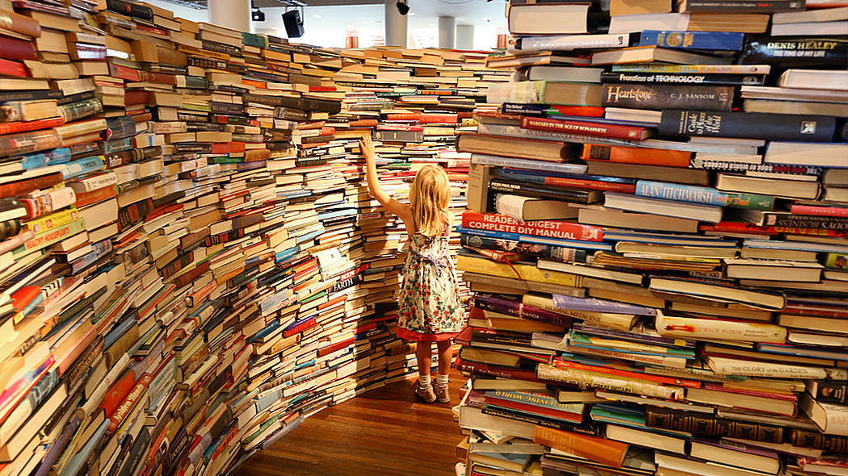
Motivation for Topic Modelling
Notes:
The inundated information available, makes it difficult to access what we are looking for.
Difficult to access what we are looking for.
Hence there is a huge demand for new tools to help us organize, search, and understand these vast amounts of information.

Slide 4
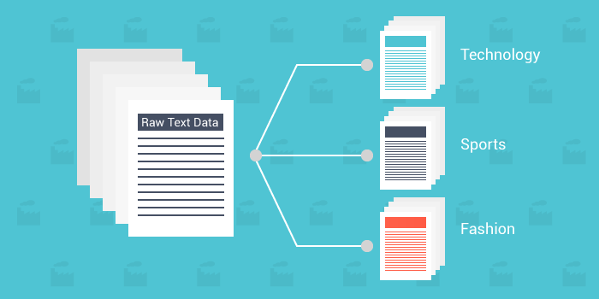
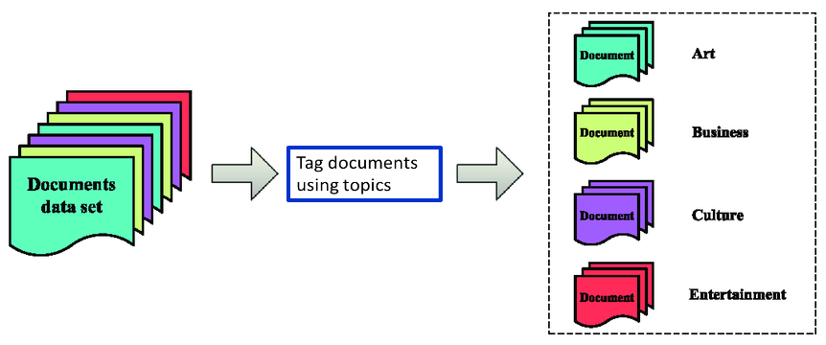
Objectives of Topic Modelling
Use these annotations to organize, summarize and search the documents.
Notes:
Discover the topics from the collection.
Tag the documents using the topics.
Use the annotations to organize, summarize, and search the texts.
Helps the user to explore the content in a organized manner
Helps the user to explore the change in the topics over time mainly in scientific articles
This is very interesting problem since it tells us to uncover the topics where the training data also does not need any annotated data it learns on its own from the training data

Slide 5
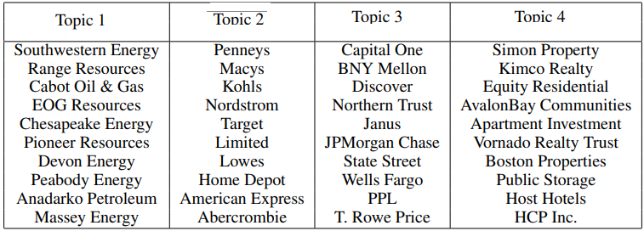
Sample output from the LDA
Four topics learned from the S&P 500 stock market data
Goal is to find groups of stocks that tend to move together.
The topic model does not provide any label to these group of words.
Notes:
Topic: Set of words that occur a lot
Topic model get us the document has the following topics by just grouping words under themes but does not provide any label
In each theme it tells us that the occurrence of these words has high probability.
It can tells us that there are K themes in the collection
Once these themes are available it tells us that how many themes each document has and what is the proportions

Slide 6
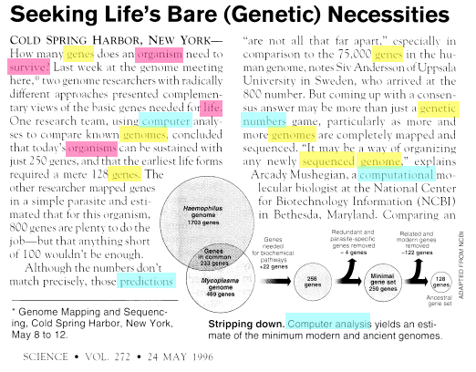
Genetics
Evolutionary biology
Data Analysis
Notes:
Simple intuition: Documents exhibit multiple topics.
This article is a composition of three mentioned themes the idea of topic modelling is to label these topics to the documents.
This article consists of different proportions of these themes.
The entire corpus may have many themes but each document will contain only a few subset of themes which we need to uncover automatically.
Consider data as observations(documents) that arise from a generative probabilistic process that includes hidden variables(topics).
Infer the hidden structure using posterior inference
What are the topics that describe this collection?
Topic model captures this intution about the collection having topics(probability distribution over words) and each document containing a mixture of topics.

Slide 7
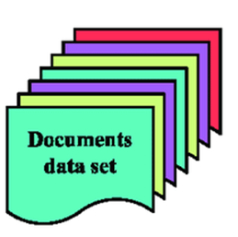
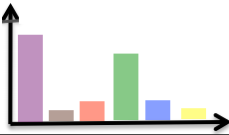
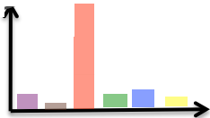
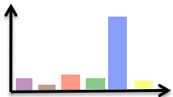
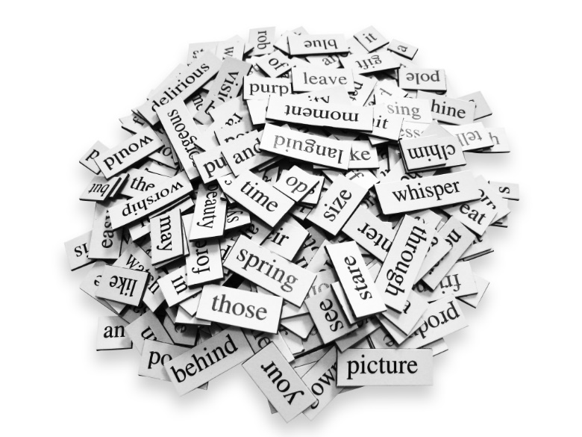
Overall schematic
Each topic is defined as a Multinomial distribution over the vocabulary, parameterized by ϕ_{k}
Corpus
T₁ | T₂ | T₃
Documents(d₁…d_{n})
K-Topics (Hyper Parameter)
d₁
Each document has a distribution over K topics
Vocabulary(W₁…W_{m})
Notes:
Each topic is defined as a Multinomial distribution over the vocabulary, parameterized by ϕk
A topic is visualized as its high probability words.
Each document has a distribution over K topics
Each topic will have some words with high probability and some with low.
As per the generative model we first generate the topics and then generate the documents using the proportion of topics

Slide 8
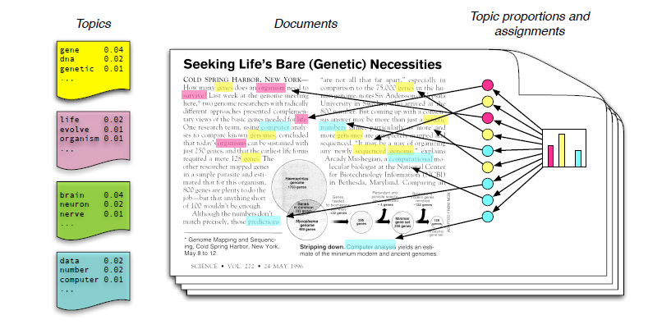
Generative model for Topic Model
Notes:
Each topic is a probability distribution over words in the corpus for example the yellow topic has gene with probability of 0.04,dna as 0.02 etc..
Each document if a mixture of corpus wide topics for example the histogram shows the proportion of the topics in a sample document. Now we need to generate the words in the document. Since the topic is a probability distribution over words we draw sample form this distribution and keep repeating.
This a imaginary probabilistic generative process but we actually do not have all this.

Slide 9
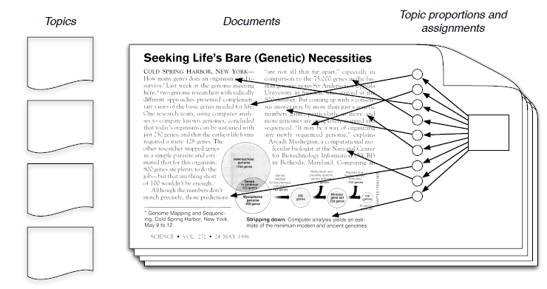
The posterior distribution
Notes:
We just get to observe out huge collection of documents. Hence our goal is to infer the underlying topic structure.
In a generative model we observe the data and estimate the parameters that maximize the likelihood of seeing the observation basically we are trying to reverse the whole process we discussed till now.
The documents are observed and
we do not know the thematic structure in it
what are distribution of words within the topics
What will the distribution of each topic in a document
For each word in a document what will be the topic assignment?
All these are hidden variables within the document which needs to be estimated by the LDA

Slide 10

Bernoulli Trial
Any single trial with two possible outcomes can be modeled as a Bernoulli trial: team wins/loses, pitch is a strike/ball, coin comes up heads or tails, etc.
A Bernoulli trial uses Bernoulli distribution to calculate the probability of either outcome.
Bernoulli trial
Notes:
When you flip a coin you get either heads or tails as an outcome (barring the possibility it lands on it’s side). This single coin flip is an example of a Bernoulli trial and we can use the Bernoulli distribution to calculate the probability of either outcome. Any single trial with two possible outcomes can be modeled as a Bernoulli trial: team wins/loses, pitch is a strike/ball, coin comes up heads or tails, etc.

Slide 11
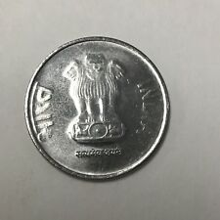
Bernoulli: A Special Case of the Binomial Distribution
Binomial Trail: Chance of getting
n heads in a row(n=3)
Bernoulli Trail: Chance of getting
a heads on a single flip
Notes:
To clarify, if I want to calculate the probability of getting heads on a single coin flip I will use a bernoulli distribution. However, if I want to know the probability of getting 2 heads (or more) in a row, we would use the binomial distribution. For our purposes we are only concerned about the outcome of a single coin flip and will therefore stick to the Bernoulli distribution.

Slide 12
Bernoulli - Distribution Notation
The probability mass function of the Bernoulli distribution is
f(x)=P(X=k)=ϴ^{k}(1− ϴ)^{1−k}, k={0,1}
The only parameter of the bernoulli distribution is θ, which defines the probability of success during a bernoulli trial.

Slide 13
Binomial distribution

Slide 14
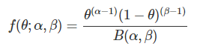
Beta Distribution
The probability distribution function for the beta distribution

Slide 15
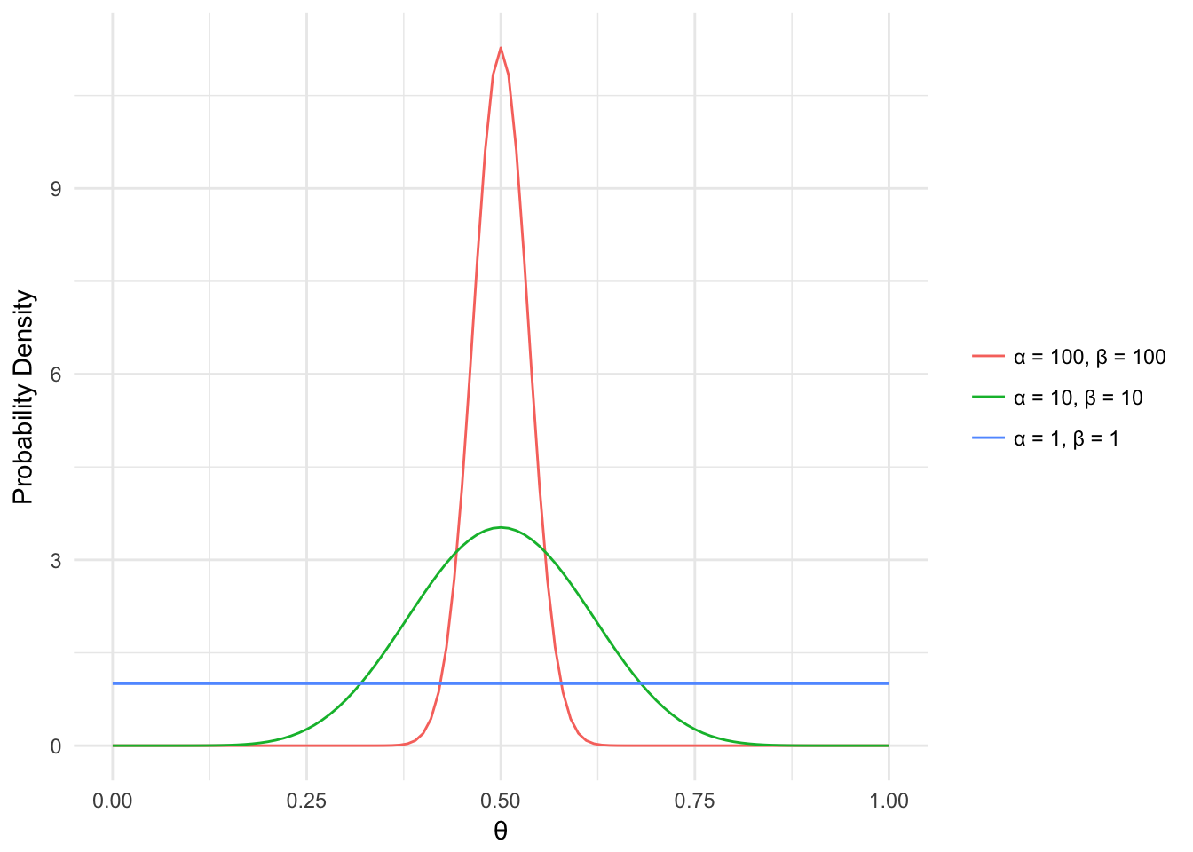
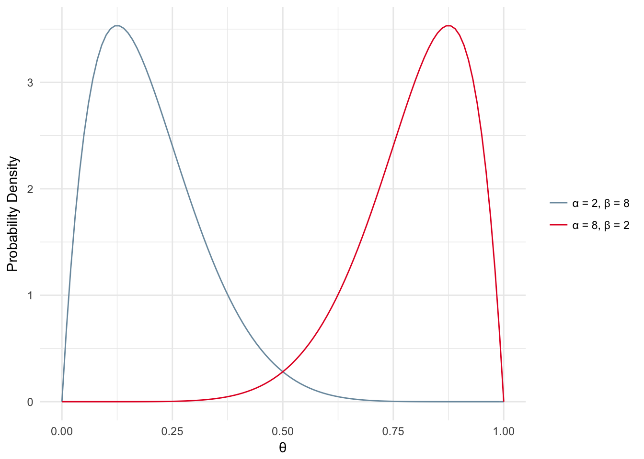
Beta Distribution
The beta distribution can be thought of as a probability distribution of probabilities.

Slide 16
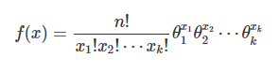
From Dice to words
Suppose we roll our die of words having k sides(vocabulary) where each side takes probabilities ϴ₁, . . . , ɵ ϴ_{k} respectively.
Probability mass function
latent
computer
d
a
t
a
k - number of sides on the die
n - number of times the die will be rolled
Notes:
A multinomial distribution can have more than 2 outcomes.
Traditionally used to model the probability of words in a document.

Slide 17
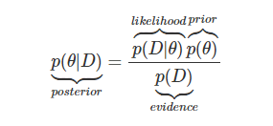
The Building Blocks of inferring the parameters
Parameter estimation
Maximum Likelihood
Maximum a Posterior (MAP)
Bayesian Inference

Slide 18
Conjugate Prior

Slide 19
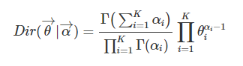
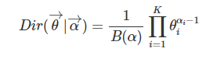
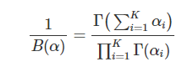
Dirichlet distributions
Dirichlet distributions are probability distributions over multinomial parameter vectors
They are called Beta distributions when k = 2
The Dirichlet probability density function is defined as
where

Slide 20
Visualization of the simplex
This is often referred as simplex and a most convenient way to visualize this is using a certain shapes depending upon the number of topics.
Suppose K=2 topics which can be modeled as 1-simplex and can be visualized using a line.
(1,0)
(0,1)
X₁+X₂=1

Slide 21
Visualization of the simplex(Contd…)
Suppose K=3 topics which can be modeled as 2-simplex and can be visualized using a triangle.
If we have K topics this can be generated using K-1 simplex.
(0,0,1)
(1,0,0)
(0,1,0)
X₁+X₂₊X₃=1

Slide 22
Dirichlet distribution is parametrized by α

Slide 23
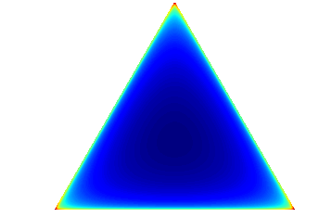
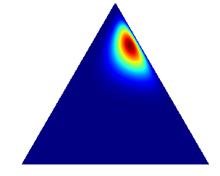
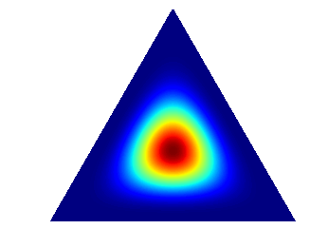
Shape of the Dirichlet distribution
Dirichlet(0.999, 0.999, 0.999)
Dirichlet(2, 5, 15)
Dirichlet(5, 5, 5)
Notes:
When the values of alpha are below 1.0, the majority of the probability mass is in the "corners" of the simplex, generating mostly documents that have a small number of topics. When the values of alpha are above 1.0, the majority of the generated documents tend to contain all the topics.

Slide 24
The posterior distribution
Notes:
Given the documents
What are the topics that generated the documents?
For each document what is the distribution of topics?
Which topic generated each word?
Our goal is to infer the underlying topic structure
We get to only observe the documents and estimate the following parameters:
What are topics?
What is the topic proportions for each document?
What is per document per word topic assignment?

Slide 26
Directed graphical model
Y
Y
X₁
X₂
. . .
X_{N}
X_{n}
N
Notes:
Nodes are random Variables
Edges denote dependency
X1,X2..XN which are observed are dependent variables
Plates are used to denote the replicated structure

Slide 27
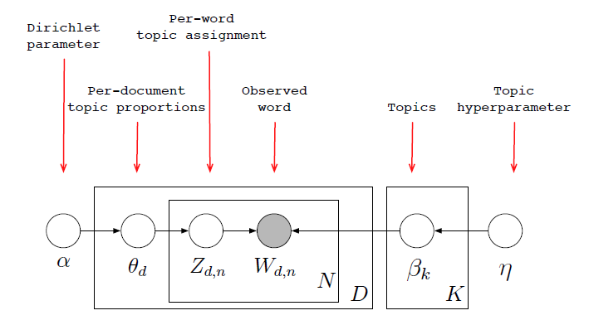
Directed graphical model of LDA

Slide 28
Directed graphical model of LDA (Contd..)
Draw each topic β_{i} ~ Dir(η), for i є {1,2,…K}
For each document
Draw each topic proportions θ_{d} ~ Dir(α)
Draw Z_{d,n} ~ Multinomial(θ_{d})
Draw W_{d,n} ~ Multinomial(βz_{d,n})

Slide 29
Draw each topic β_{i} ~ Dir(η), for i є {1,2,…K}
For each document
Draw each topic proportions θ_{d} ~ Dir(α)
Draw Z_{d,n} ~ Multinomial(θ_{d})
Draw W_{d,n} ~ Multinomial(βz_{d,n})

Slide 30
Gibbs Sampling

Slide 31
Gibbs Sampling (Contd…)

Slide 32
Algorithm
Step1: Assign a random topic [1…T] for each word
Step2: For each word token, a new topic is sampled as per P(z_{i}=j|z_{-I},w_{i},d_{i}) and the matrices Cwt and Cdt are updated.
One iteration over all word token in the document is a Gibbs Sample
Each iteration may have correlation with the next hence these samples are saved at spaced intervals.

Slide 33
Estimate for θ and β

Slide 36
Thank You!

